Slide 1




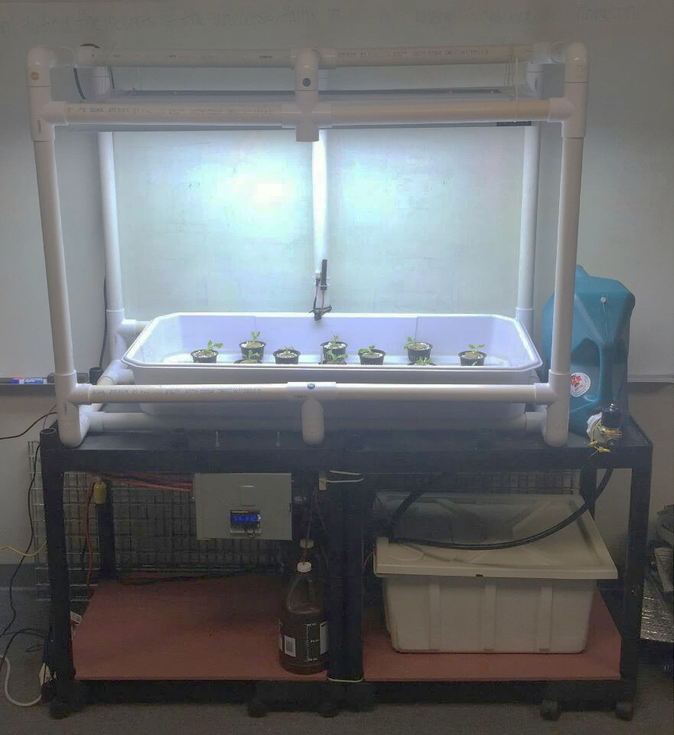
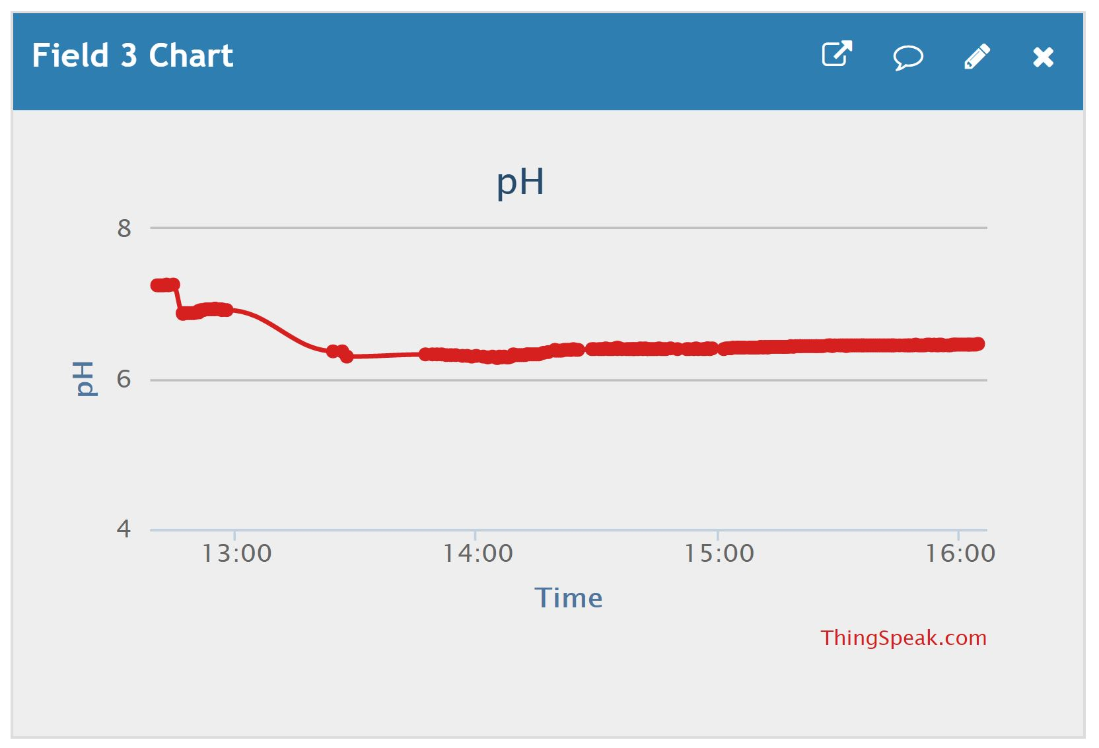
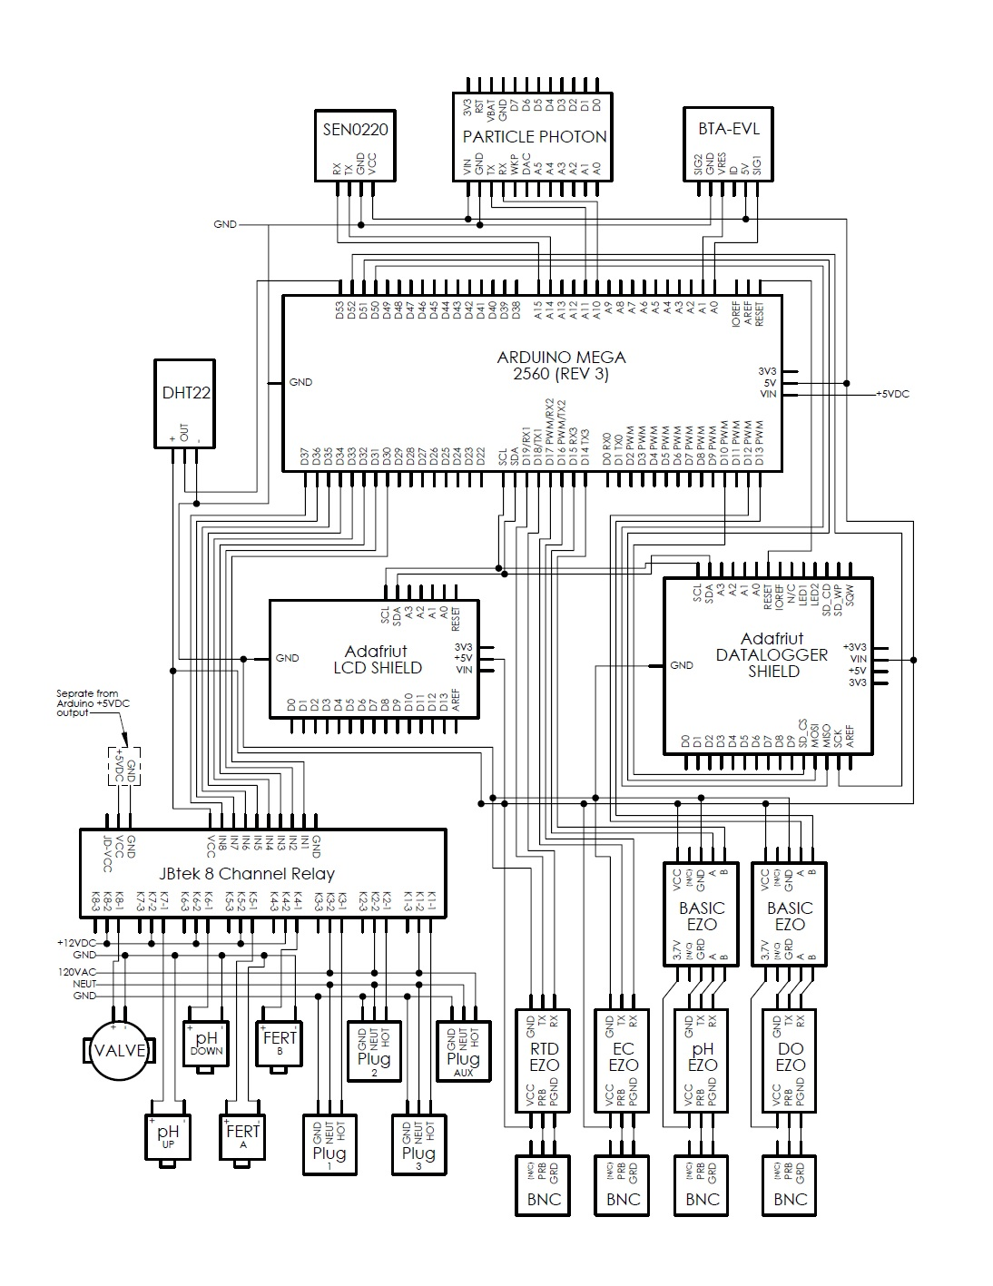
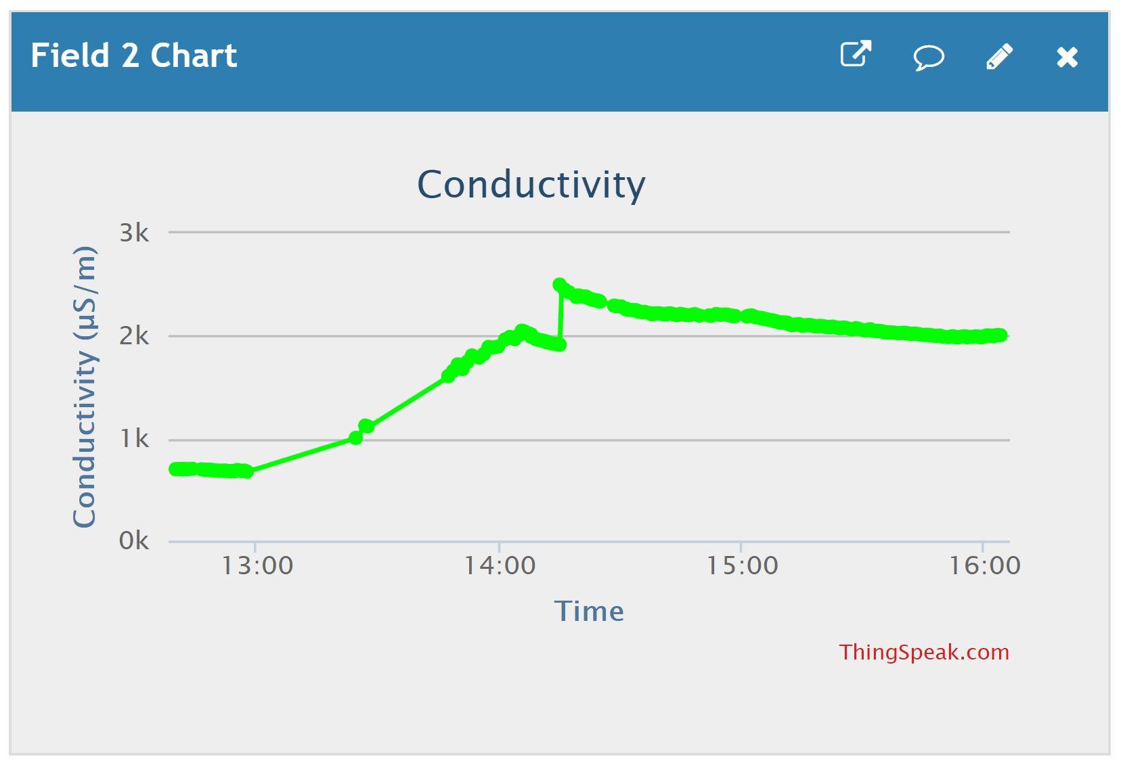
Automation and Control of Hydroponic Systems
Marshall Amey, Kathya Alfaro, Isaac Olson, Madeline Wrzesinski, Pete R. Ortega (Advisor)
San Antonio College, CIMA-LSAMP
ABSTRACT
METHODS
RESULTS
CHALLENGES
Optimizing the production of automated hydroponic systems for cost-efficiency and ease of operation, could revitalize the health of low-income and urban communities that are located in food deserts. With these systems communities would have close access to healthier, more natural food options year-round. By creating simple technology that optimizes plant yield at the lowest cost, more research can be done to study the potential benefits of environmental sustainability that would end hunger, locally and abroad. This project used Arduino microcontroller technology and an array of sensors to measure pH, conductivity, and oxygen levels of the nutrient solution; temperature, humidity and CO2 levels in the air; and the photosynthetically active radiation of the lights. The data compiled by the system is uploaded to the Internet, where it can be viewed remotely.
Find appropriate levels of pH for specified plants. The appropriate pH range for the radishes that were tested was 6.0-7.0
Calibrate each sensor
Set carbon dioxide, humidity, and temperature sensors above a grow bin
Set pH, conductivity, water temperature, and dissolved oxygen sensors in nutrient water reservoir
Place grow lights above a grow bin and automate them using an Arduino data logger shield
Figure 1. Completed hydroponic system
Once the system was assembled, data was gathered from eight different sensors. The values of those readings were reported to the internet via
Wi-Fi. It was then possible to test the system’s ability to regulate pH and conductivity levels automatically. After the system’s functionality was tested and verified, plants were added thus beginning the growth phase.
Adding a menu to the LCD screen was unsuccessful
Conductivity readings were unreliable because of interference from other devices
Wi-Fi connectivity was difficult to establish because of hardware problems
FUTURE WORK
The natural next step in this project is to add plants for growth pattern testing. In order to decrease human involvement in the system, the following additions should be made:
Control air temperature, water temperature, light intensity, light color, carbon dioxide and nitrogen
Protect water reservoir from outer elements (seal water reservoir)
Install video surveillance system
Wrap entire system in an enclosure
Install reliable fresh water access for the reservoir
BACKGROUND
The human population is growing rapidly and will reach approximately 9 billion in the next 30 years (Touliatos, 2016). In order to meet the growing demand for food, there will need to be a 70% increase in agricultural production (Corvalan et al. 2005; Tilman et al. 2011). Because the earth’s resources are already strained, it is important to find alternative food production that does not involve further land degradation, depletion of soil, and loss of biodiversity.
Growing leafy greens and herbs inside shipping containers has become a new and exciting niche in the agricultural industry. The low cost and efficiency of these systems shows much promise in alleviating some of the negative effects of current agricultural practices. A well-designed prototype system that is simple for the average student to understand and manipulate will go a long way in improving research efforts to maximize the use of this type of technology.
Figure 3. pH Graph during automation
When fresh tap water was added to the main reservoir, the system was turned on and tested for functionality. Figure 3 shows how the program reduced the pH from 6.92 to 6.19. The program added 3 mL of pH DOWN solution to the water reservoir every minute while the air pump mixed the solution. This first process was completed in 10 minutes. It took 30 mL of the solution to complete.
REFERENCES
Touliatos, Dionysios, Dodd, Ian C., & McAinsh Martin. (2016, April
21). Vertical farming increases lettuce yield per unit area compared to
conventional horizontal hydroponics. Food and Energy
Security, 5(3), 194-191. doi: 10.1002/fes3.83
Corvalan, C., S. Hales, and A. J. McMichael. (2005). Ecosystems and
human well-being: health synthesis. World Health Organization.
Tilman, D., C. Balzer, J. Hill, and B. L. Befort. (2011). Global food
demand and the sustainable intensification of agriculture. Proc. Natl
Acad. Sci. USA 108:20260–20264.
OBJECTIVES
Design, build, and test a low-cost system for remotely monitoring critical parameters of the nutrient solution in a containerized hydroponic garden.
Use microcontroller and sensors to measure pH and conductivity of the nutrient solution, temperature and humidity of the environment at different locations, dissolved oxygen in the water, carbon dioxide in the air, and spectrum of the lighting system
Report all sensor values to the internet in order to be viewed remotely
Automate control of pH and conductivity so that they can be regulated without human intervention
Figure 4. Conductivity graph during automation test
Once the pH levels were within the necessary range, the program began to raise the conductivity level. The system added 6 mL of both nutrient A and B every minute until the conductivity level reached 2000 μS/m. In this test, the conductivity level showed a spike once the water pump started sending the solution through the system. This is possibly due to interference from the motor. After an hour, the level re-stabilized itself.
Graphs of all sensor readings can be found on the ThingSpeak website at https://thingspeak.com/channels/298095
ACKNOWLEDGEMENTS
Funding provided by the National Science Foundation CIMA LS-AMP grant (Award No. 1305001), and The Alice Kleberg Reynolds Foundation. A special thanks to Pete R. Ortega, Steven Lewis, Amanda Lewis, and Dee Dixon for providing insight, leadership, and guidance. Thanks to San Antonio College, the MESA Center, and EcoCentro for allowing the means and facilities for this project. Thanks to the members of the joint hydroponic research teams: Hydroponic Solutions the Effects of Three Light Treatments on Radishes and Basil. Their advice and support of this body of research was invaluable.
Figure 2. Wiring Diagram

